Slide 1



Programación. Python
MapReduce
Cristóbal Pareja Flores

Slide 2

Procesamiento de big data en el sistema de archivos distribuido hadoop mediante un esquema funcional a base de las operaciones “map” y “reduce”.

Slide 3

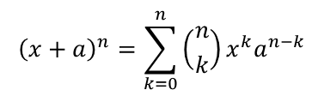



…
…
…
[ 0, 1, 2, … , k , … , n-1, n ]
map
…
…
…
…
…
reduce
índices = range (n+1) = [0, …, n]

Slide 4

[ [“Mr”, “Bennet“], 1
[“Mr”, “Netherfield”], 1
[“Mr”, “Park”], 1
[“Bennet“, “Netherfield”], 1
[“Bennet“, “Park”], 1
[“Netherfield“, “Park”], 1
]
"My dear Mr. Bennet," said his lady to him one day, "have you heard that
Netherfield Park is let at last?“
…
Now, Kitty, you may cough as much as you choose," said Mr. Bennet.
…
Elizabeth Bennet had been obliged, by the scarcity of gentlemen, to sit
down for two dances; and during part of that time, Mr. Darcy had been
standing near enough for her to hear a conversation between him and Mr.
Bingley, who came from the dance for a few minutes, to press his friend
to join it.
“[“Mr”, “Bennet“, “Netherfield”, “Park”]
[“Kitty”,
“Mr”,
“Bennet”]
[“Elizabeth”, “Bennet”,
“Mr”,
Darcy”,
“Mr”,
“Bingley”]
…
[ [“Mr”, “Bennet“], 1173
[“Mr”, “Netherfield”], 2001
[“Mr”, “Park”], 1200
[“Bennet“, “Netherfield”], 541
[“Bennet“, “Park”], 258
[“Netherfield“, “Park”], 785
]
reduce
…
map

Slide 5
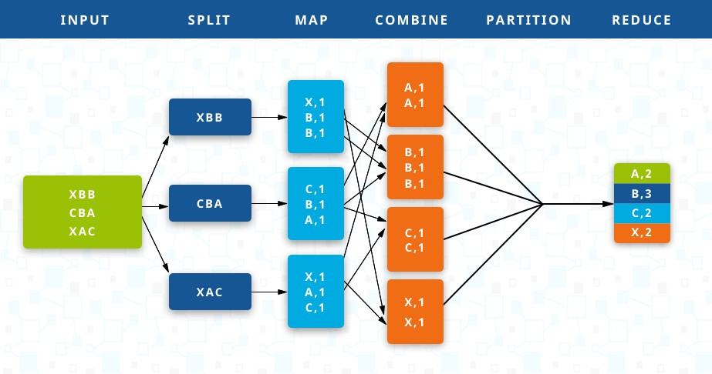
Map y reduce

Slide 6
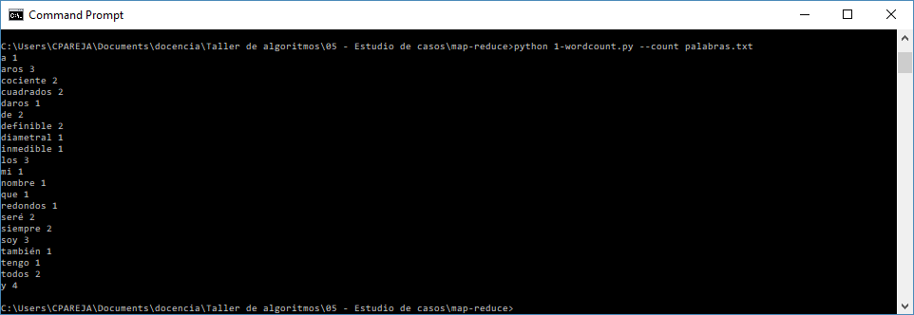
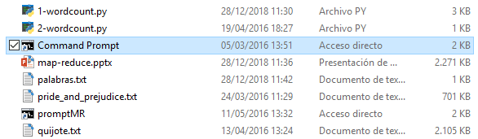
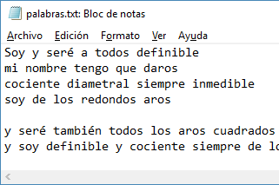
Cuenta-palabras secuencial
Objetivo

Slide 7
Cuenta-palabras secuencial

Slide 8
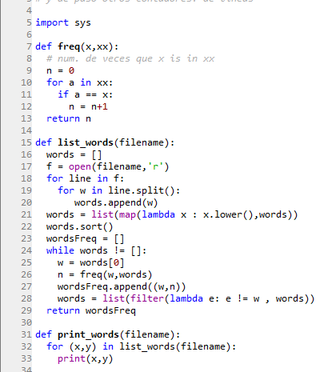
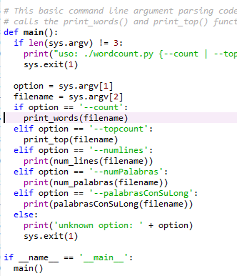
Cuenta-palabras secuencial

Slide 9
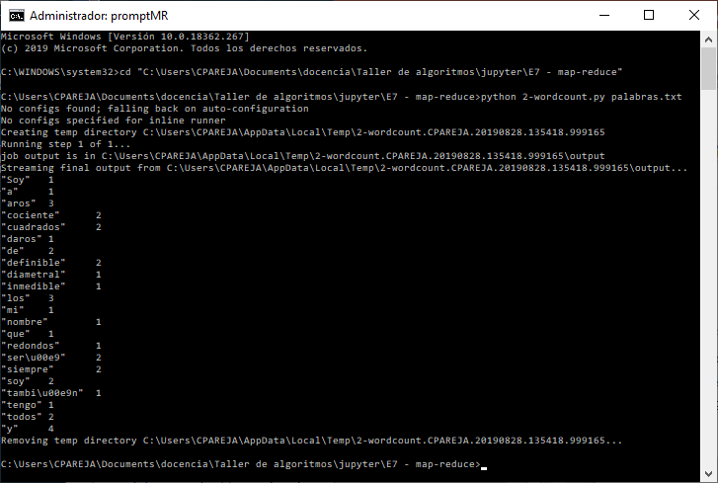
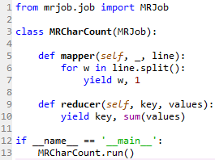
Cuenta-palabras con map-reduce

Slide 10
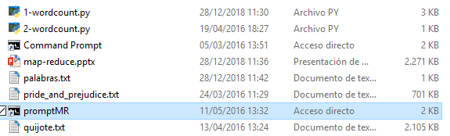
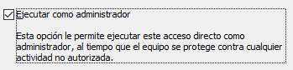
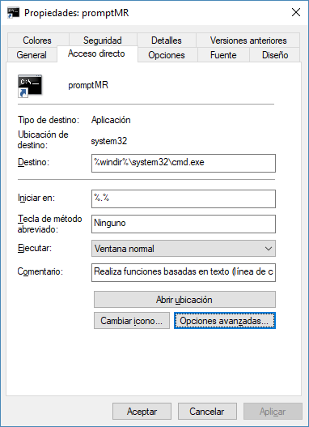
Cuenta-palabras con map-reduce

Slide 11

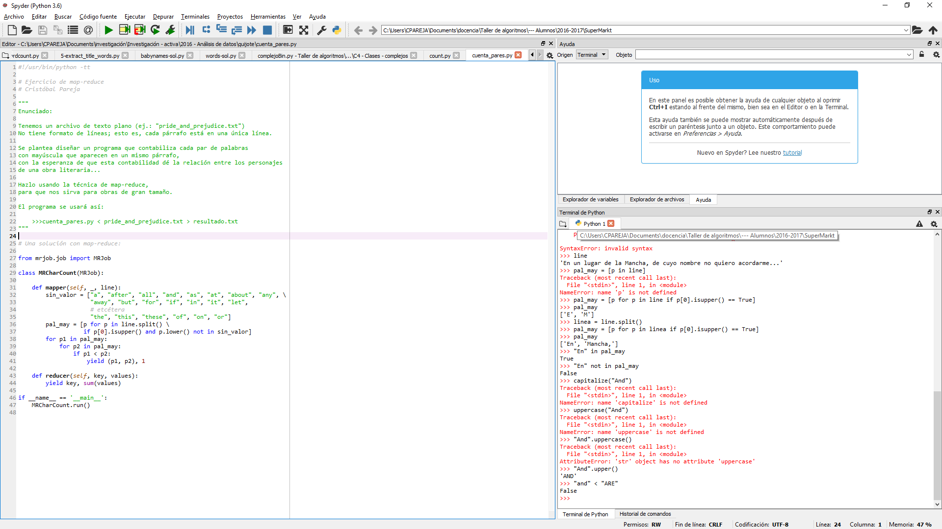
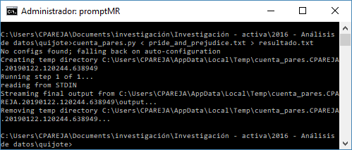
Se pide completar esto

Slide 12
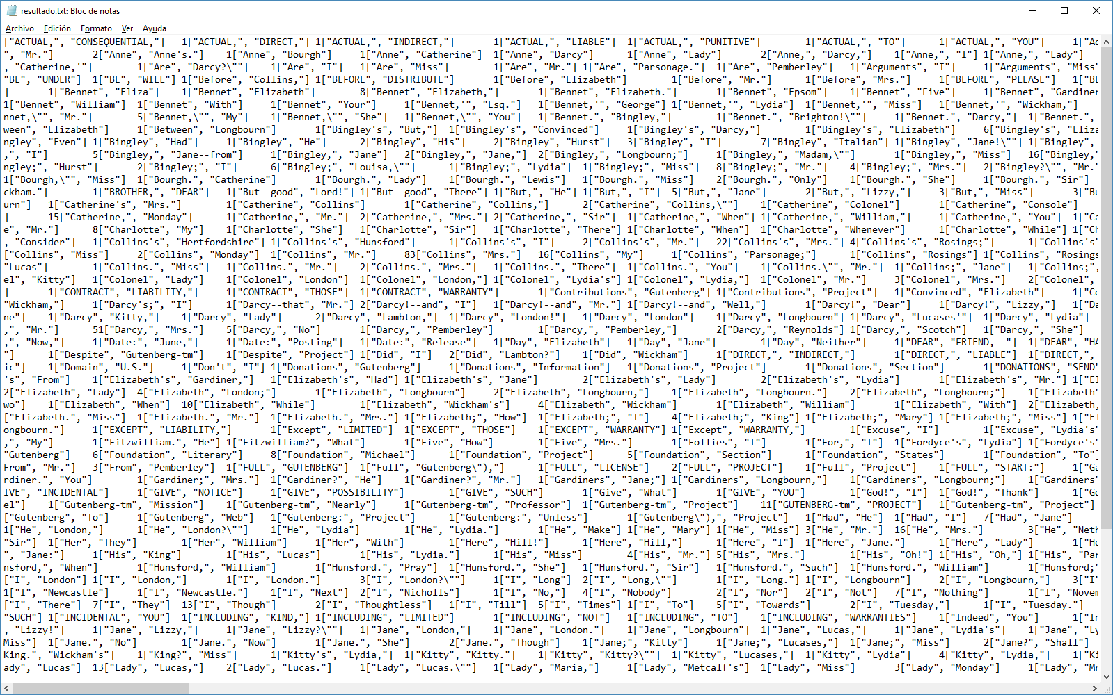
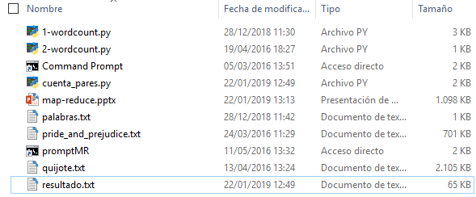


Slide 13
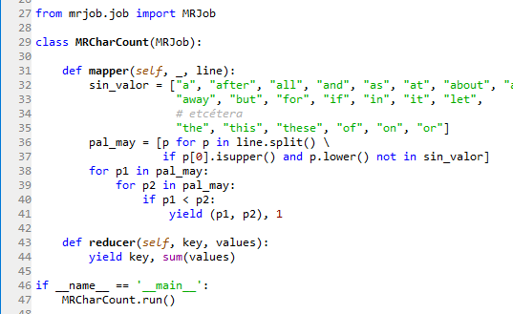

Mejoras posibles:
Evitar las palabras completamente en mayúsculas
Eliminar los signos de puntuación junto a las palabras
Seleccionar únicamente con los pares que aparecen más de … veces

Slide 14
Bibliografía
MapReduce, entrada en la Wikipedia:
  https://es.wikipedia.org/wiki/MapReduce
MapReduce tutorial, en la web oficial de Hadoop:
  https://hadoop.apache.org/docs/r1.2.1/mapred_tutorial.html

